Slide 1
Finding suitable presentation- envisionment
Ms. Iqra Shahzad, Department of Software Engineering , NUML ,Islamabad

Slide 2
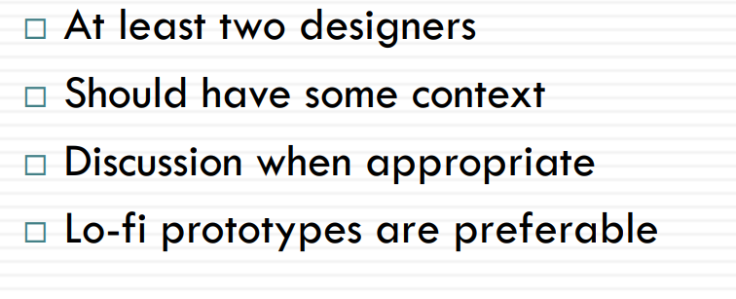
Envisionment in practice

Slide 3
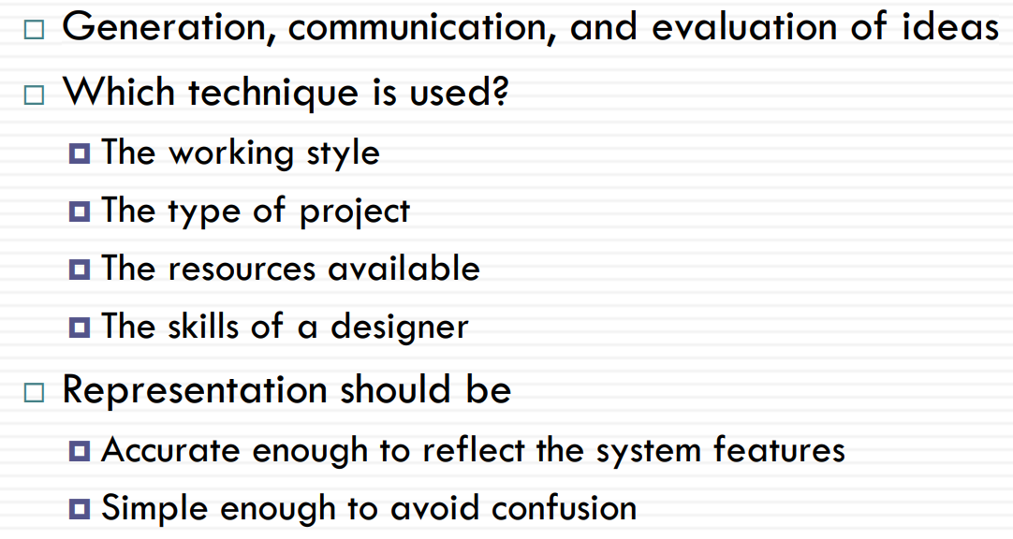
Finding Suitable Representations
How can you design computer displays that are as meaningful as possible to human viewers?
Notes:
An envisionment is meaning that is in the process of being made; it is meaning-in-motion.

Slide 4
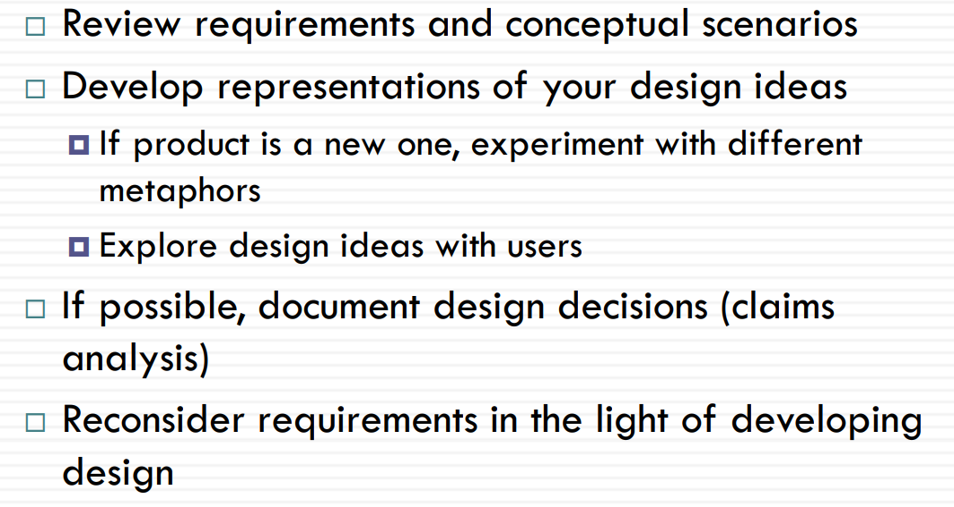
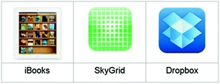
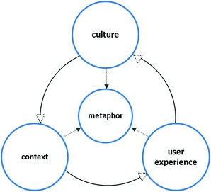
Envisionment Process
Notes:
The visual display of information

Slide 5
Sketches and Snapshots
All designers should practice it
Ideas and thoughts are visualized and explored
Millennium bridge was first designed on a paper napkin in restaurant
Designers should have sketch book

Slide 6
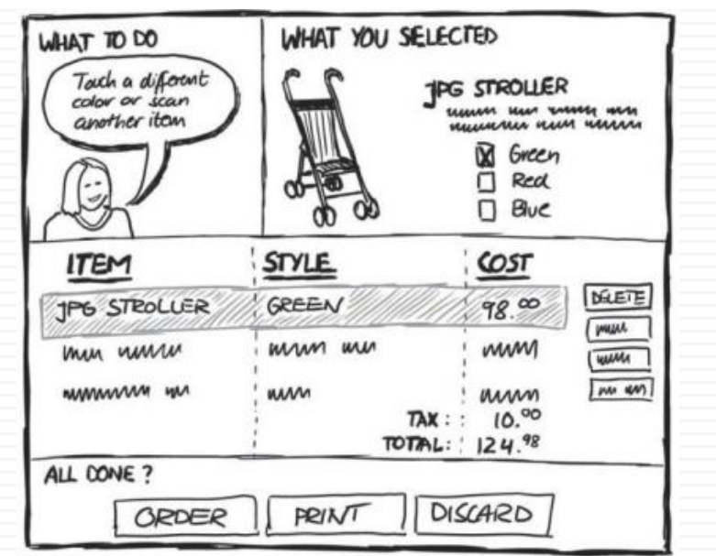
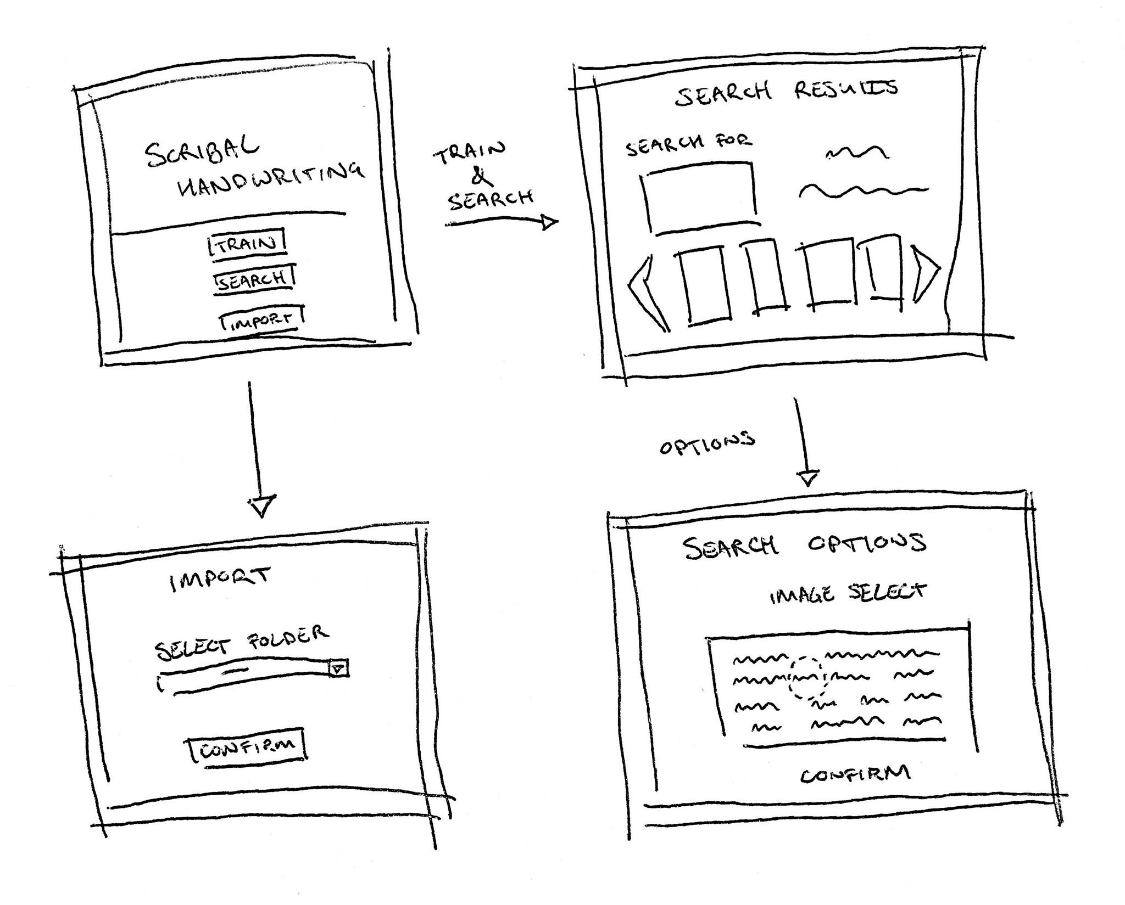

Slide 7
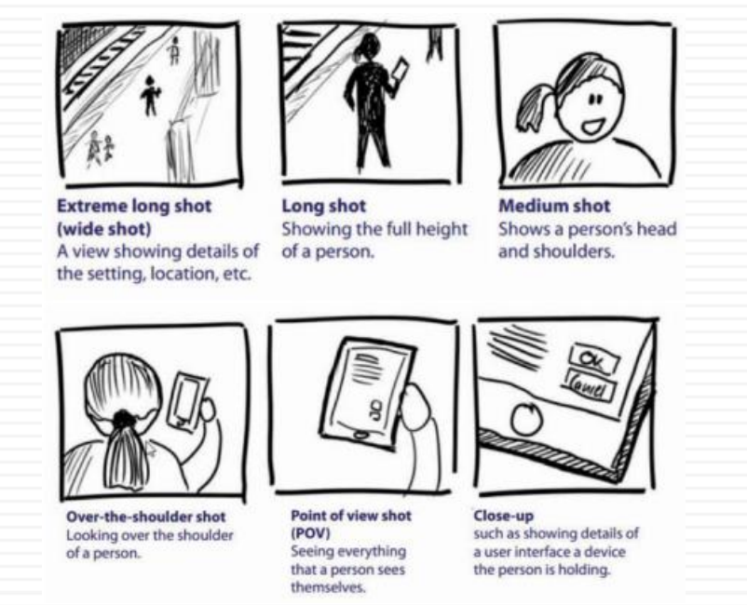
Notes:
A snapshot is an image of your system/volume at a specific point in time. The first snapshot is an exact copy of the given data volume. Subsequent snapshots store data blocks that have been changed or added, enabling quicker versioning.

Slide 8
Storyboards
Originated from filmmaking
Cartoon-like structures
Key moments are presented
Feel the ‘flow’ of experience
Economical; 6-8 scenes on a page
Based on the concrete scenarios

Slide 9
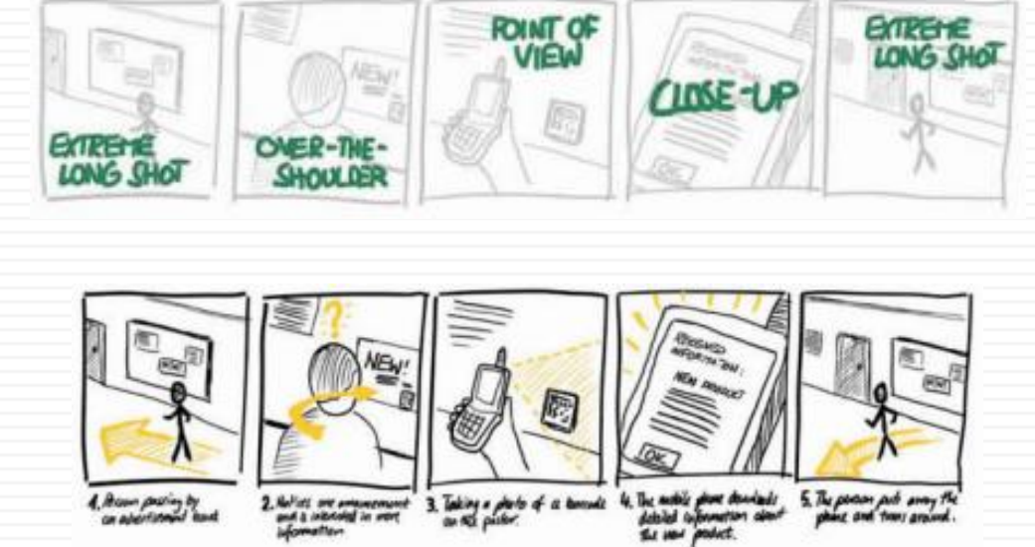

Slide 10
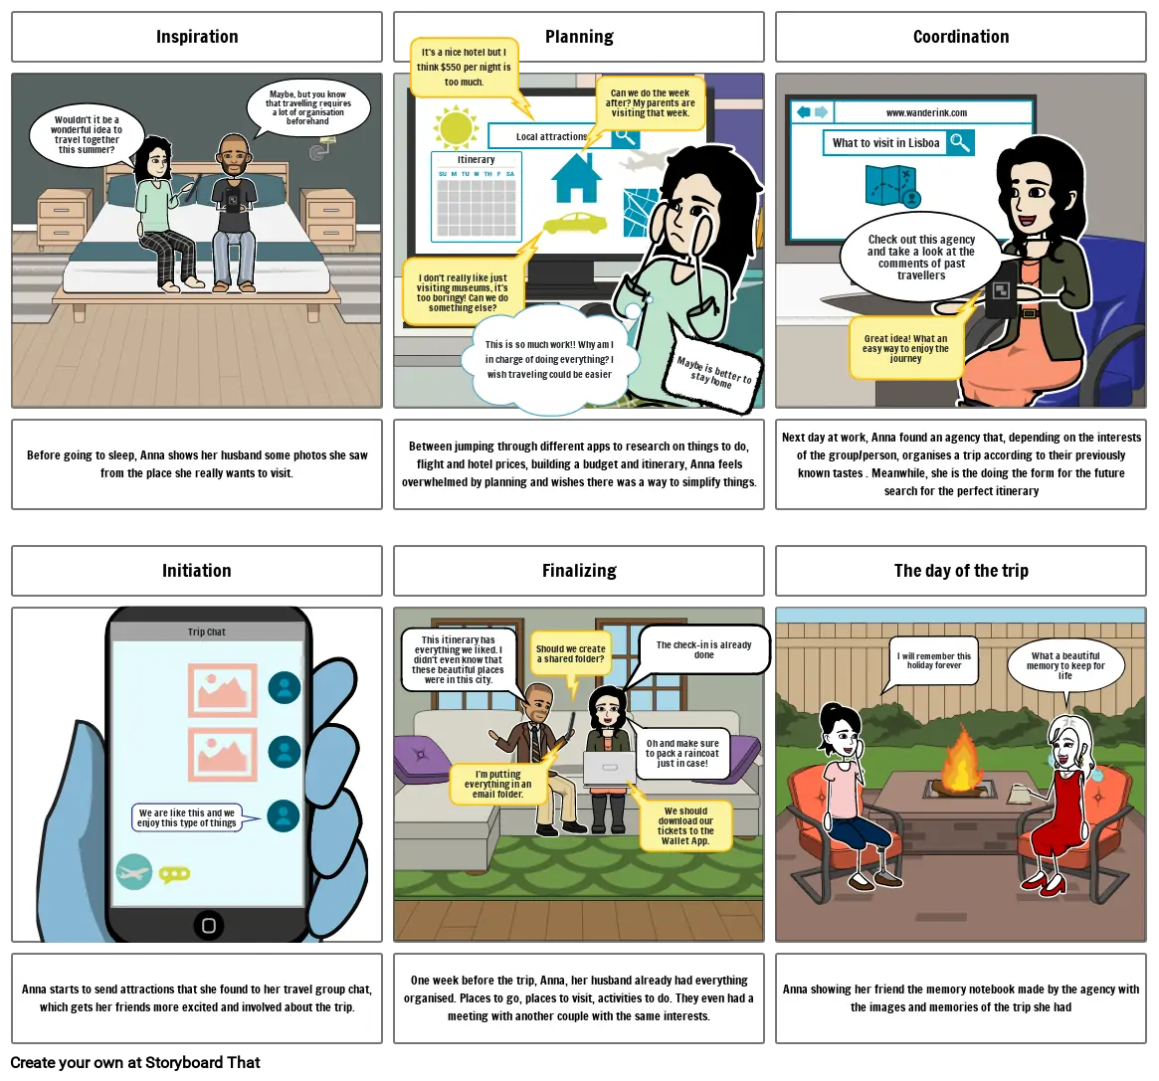

Slide 11
Mood boards
a moodboard is a picture that shows how the product should look, feel, and act.
It’s usually a mix of pictures, colors, textures, patterns, fonts, and other visual elements that capture the essence of the product’s personality and make people feel or think of things in a certain way.
This keeps the product’s vibe consistent across all its marketing stuff.

Slide 12


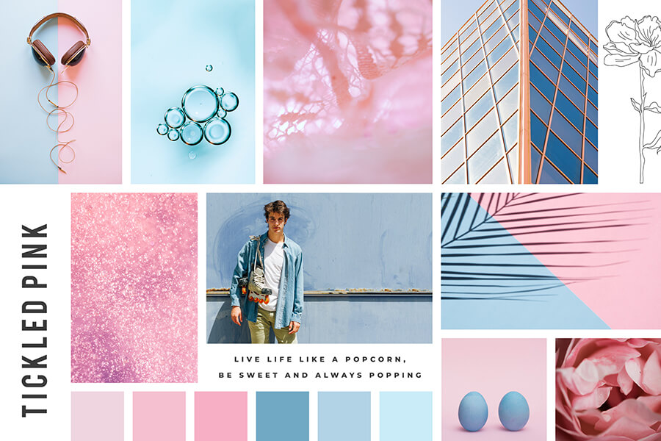

Slide 13
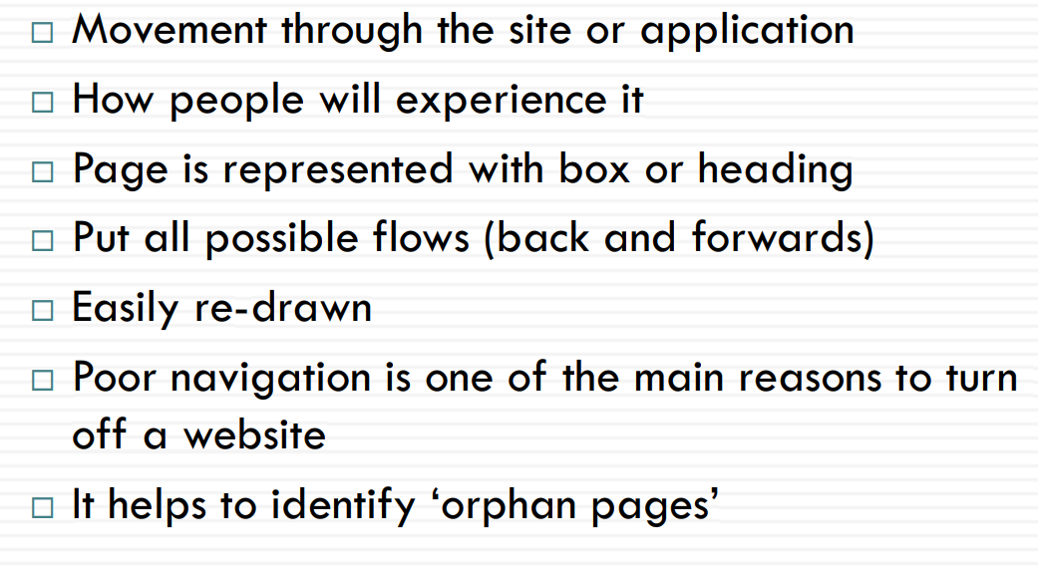
Navigation maps

Slide 14
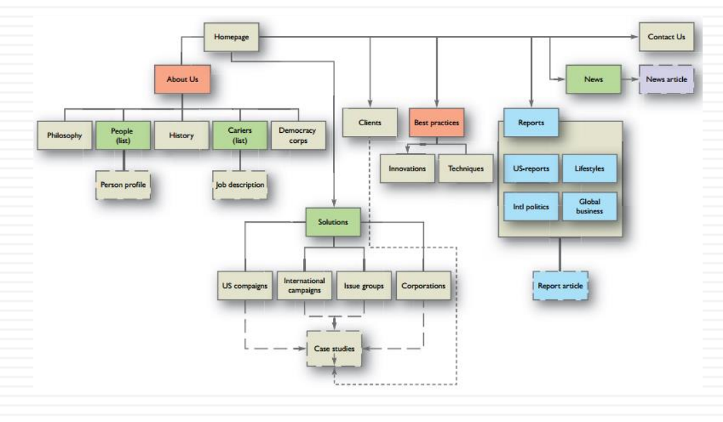

Slide 15
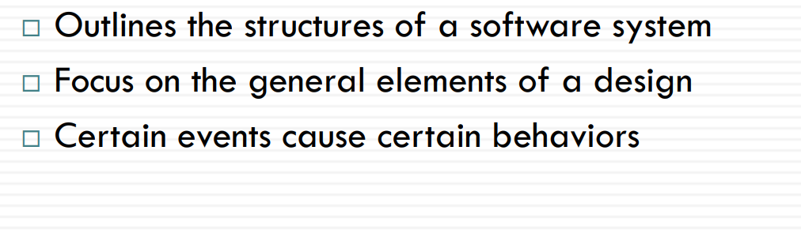
Wire frames
Wireframes are basic blueprints that help teams align on requirements, keeping UX design focused and constructive.
Think of your wireframe as the skeleton of final product
components, and features, including:
Screen layouts
Navigation bars
Components of UX and UI design
Interactive elements

Slide 16
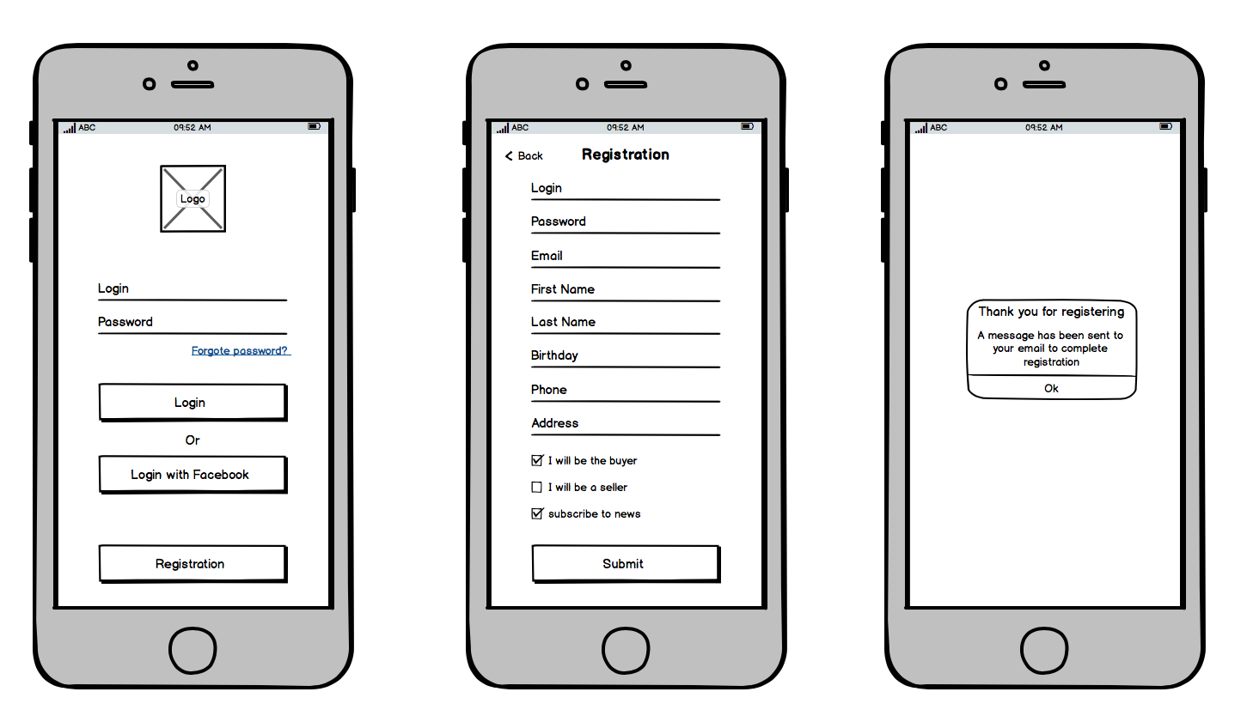
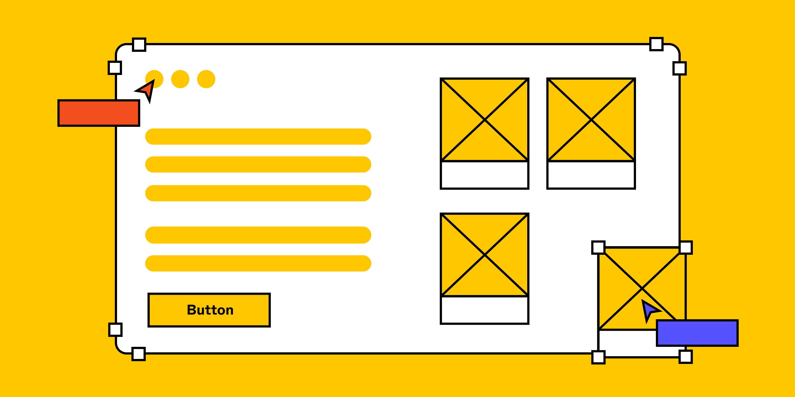

Slide 17
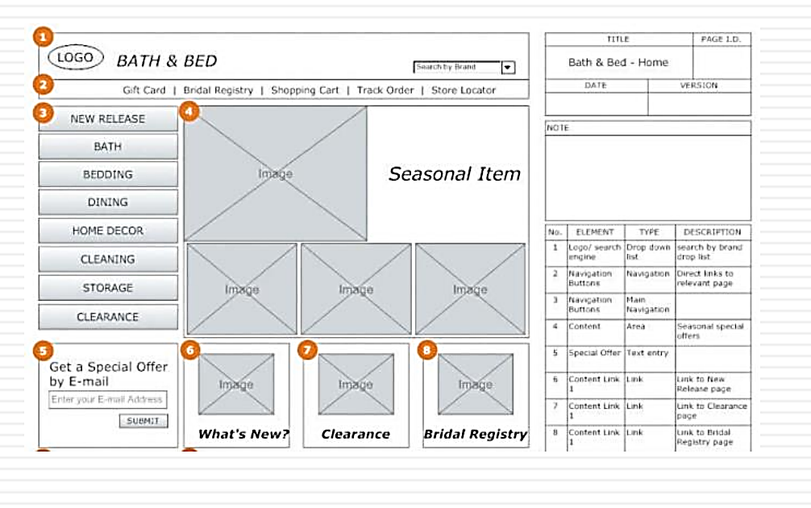

Slide 18
prototype

Slide 19
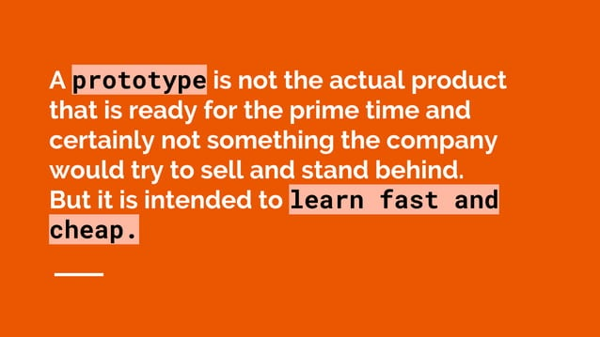
Prototype

Slide 20
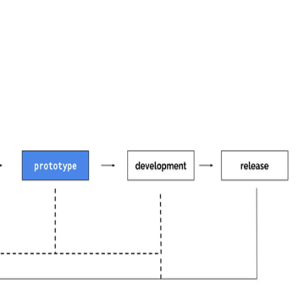

Slide 21
Types of prototypes
Paper prototypes
Low fi prototypes
High fi prototypes
User driven prototypes

Slide 22
Paper prototype
Paper prototyping apps and websites is a method some design teams use to begin conceptualizing a new product or feature.
This method involves sketching a quick outline of your product and its different screens, UI layouts and elements.
It’s a fast and cheap way to get ideas down on paper so that you can communicate them to your team and other stakeholders.
For this reason, the paper prototyping methodology is also brilliant for brainstorming and ideation sessions.

Slide 23
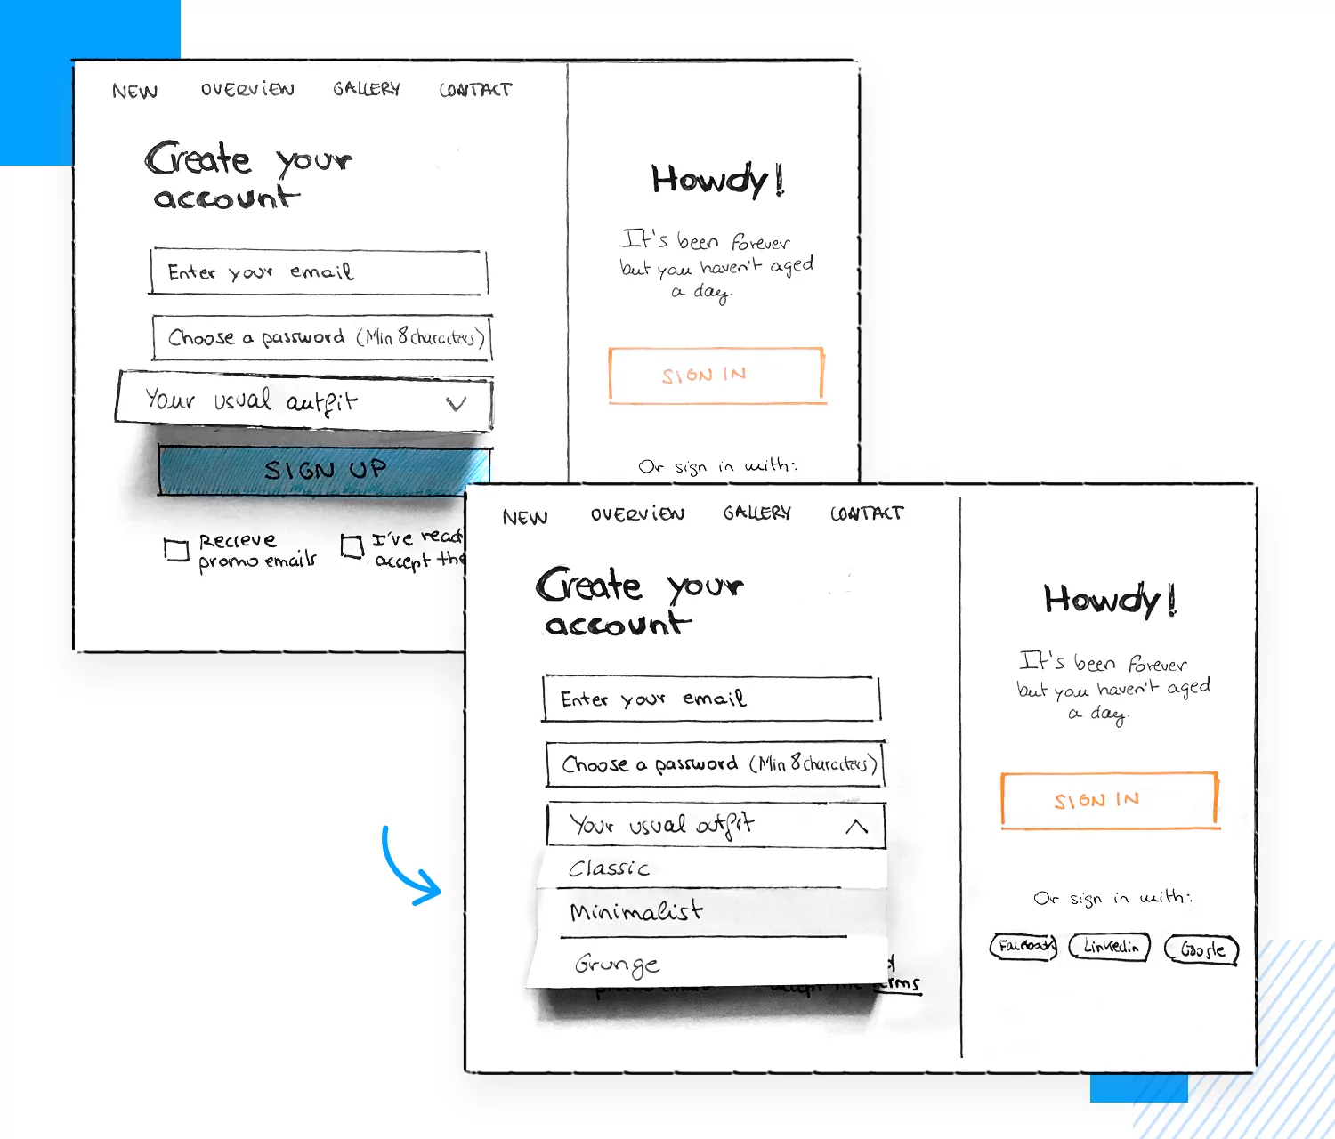
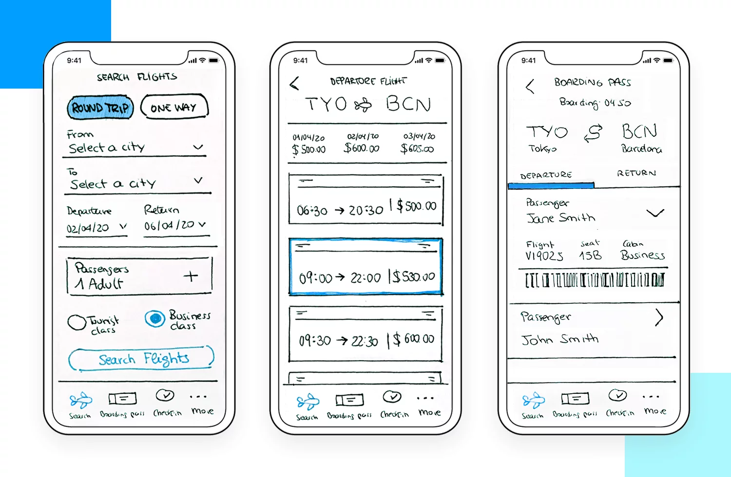
Notes:
Paper prototyping doesn’t require much detail, as designers normally do it in the very early stages of the design process. The drawings don’t have to be a work of art, but they should clearly communicate your design ideas, to the extent that you could even perform a bit of early usability testing. This is a great way to work out the information architecture of the design.

Slide 24
Low-fidelity prototypes
a low-fidelity prototype is the crucial foundation that the majority of the product’s design will be built around.
The low-fidelity prototyping methodology consists of quickly designing a digital outline of your screen’s UI consisting of various elements on the screen along with basic content.
It cuts out distraction by focusing on only the fundamental details, such as layout, spacing, element positioning, screen flow and information architecture.

Slide 25
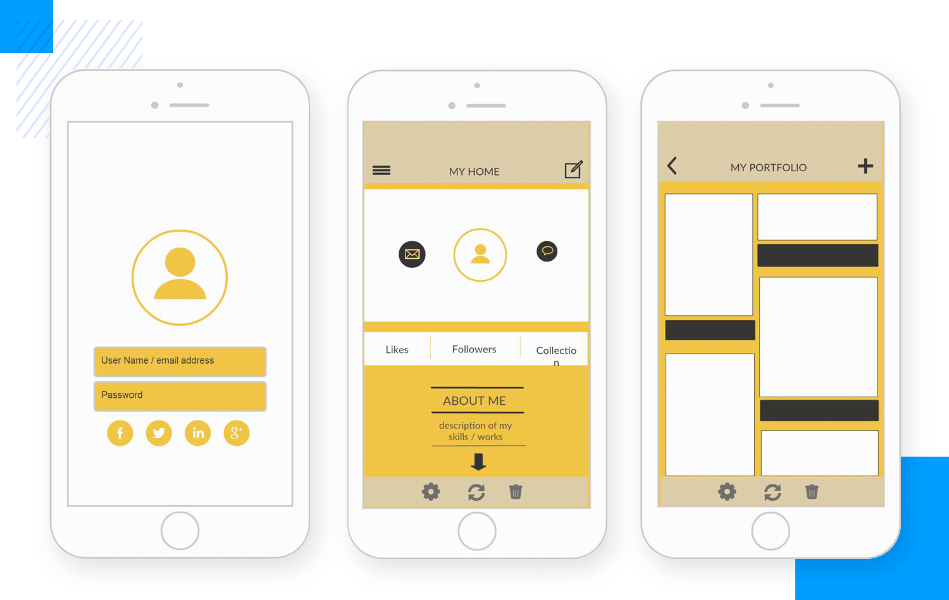
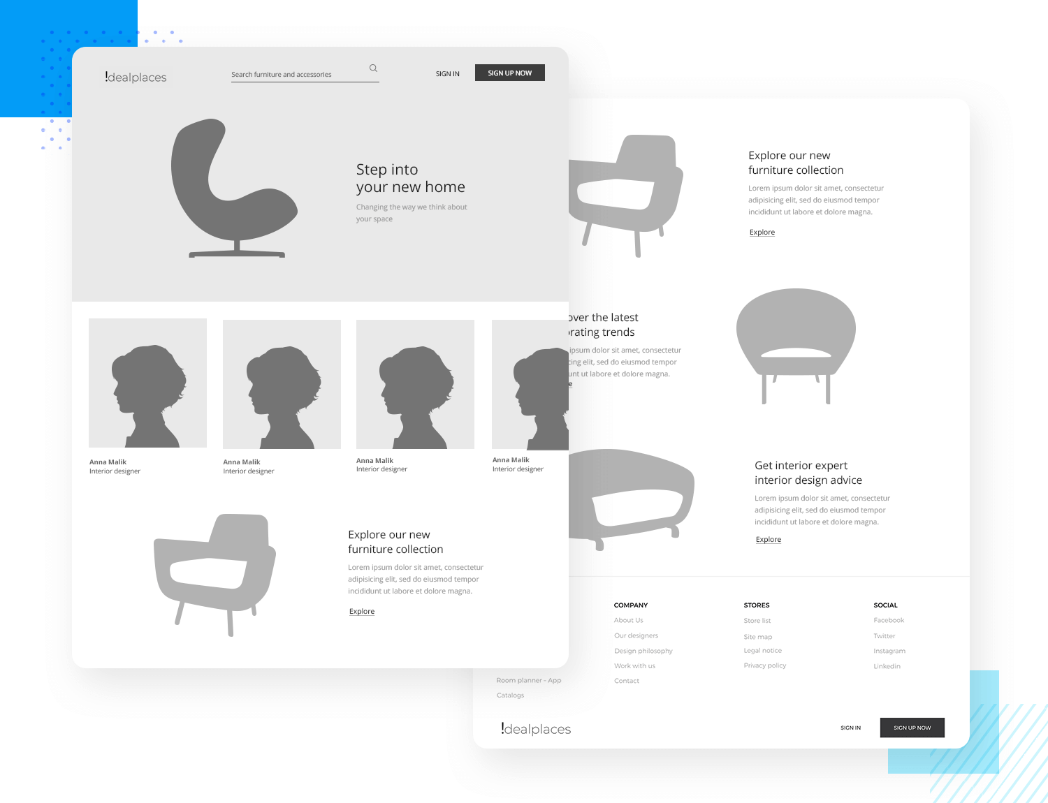
You can test low-fidelity prototypes on your users to check your product’s layouts and screen flows are intuitive.
After these basic details are validated, you can then push ahead with more advanced UI design and complex interactions.

Slide 26
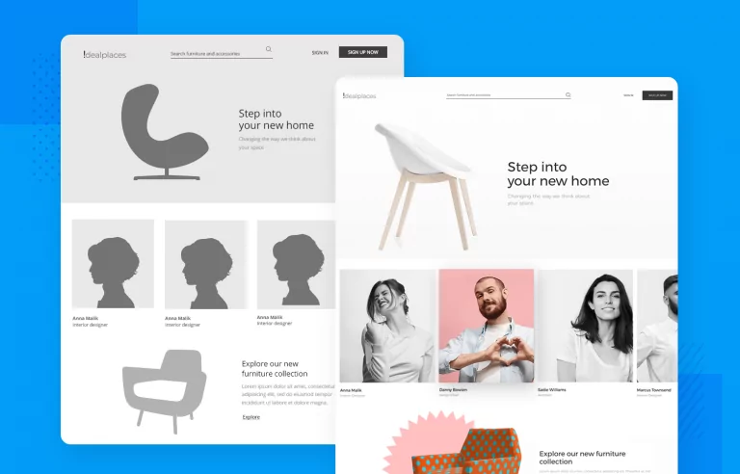
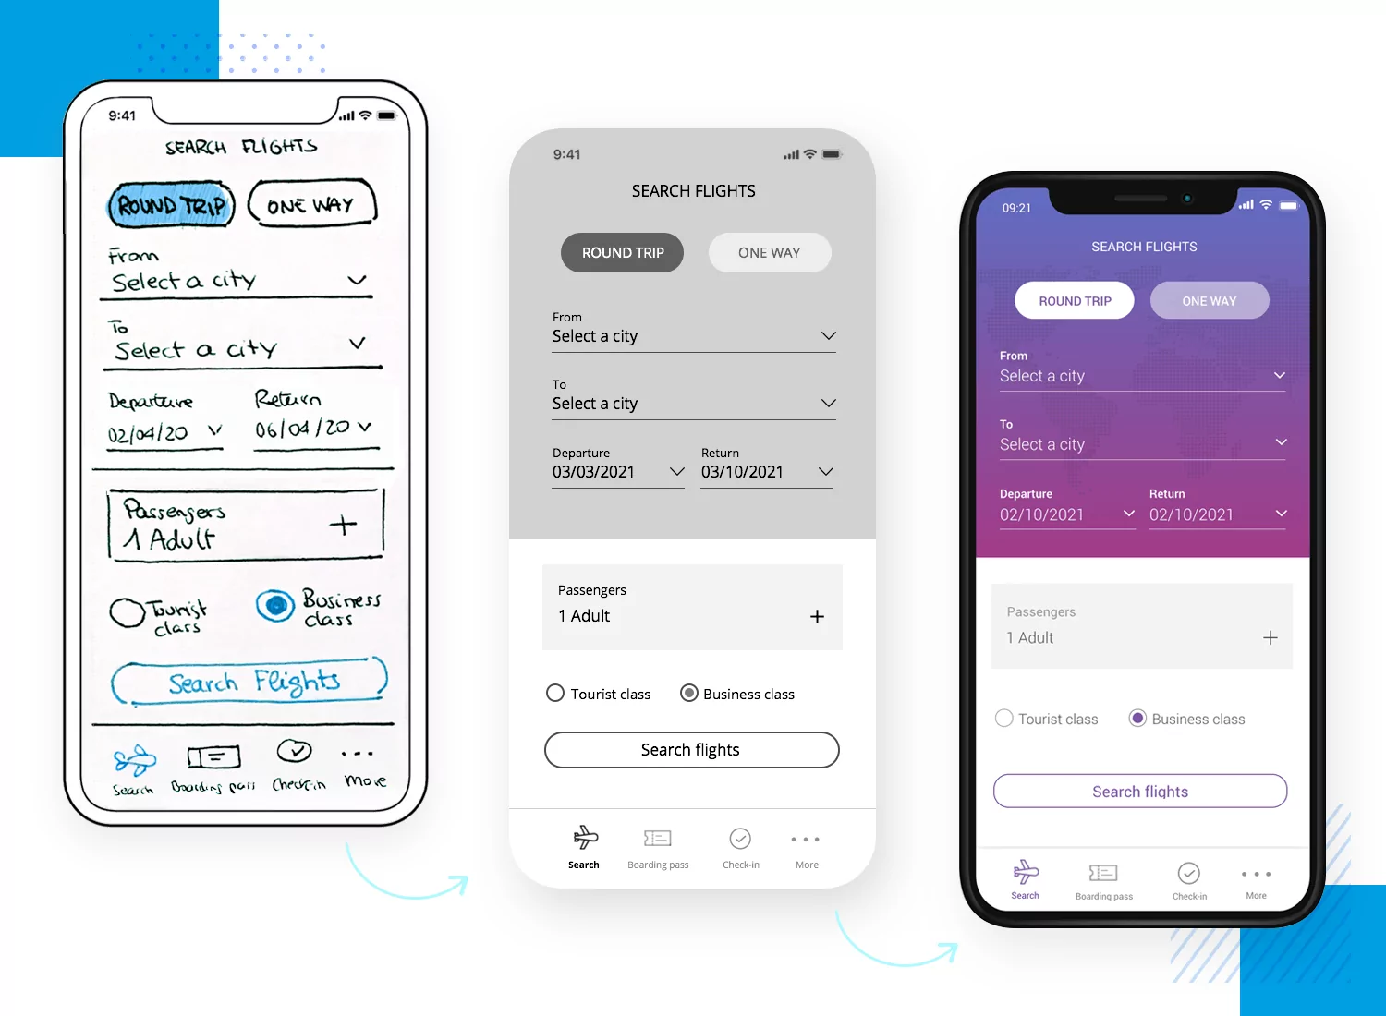
High fi prototypes:
The high-fidelity prototyping methodology means designing a pixel-perfect prototype with real images, graphics font and complex interactions.
High-fidelity prototypes are brilliant for testing on your users as they represent how the final product will be.
Once validated, it’s the last thing you’ll be handing off to your developers.
The beauty with this method is that your developers will get everything they need from the start – assets, images, color codes, fonts and they will also understand how to program the functionality and interactivity of the product.

Slide 27

User driven prototypes:
Are we getting users to design our prototypes now while we just sit back and relax? No, definitely not.

Slide 28
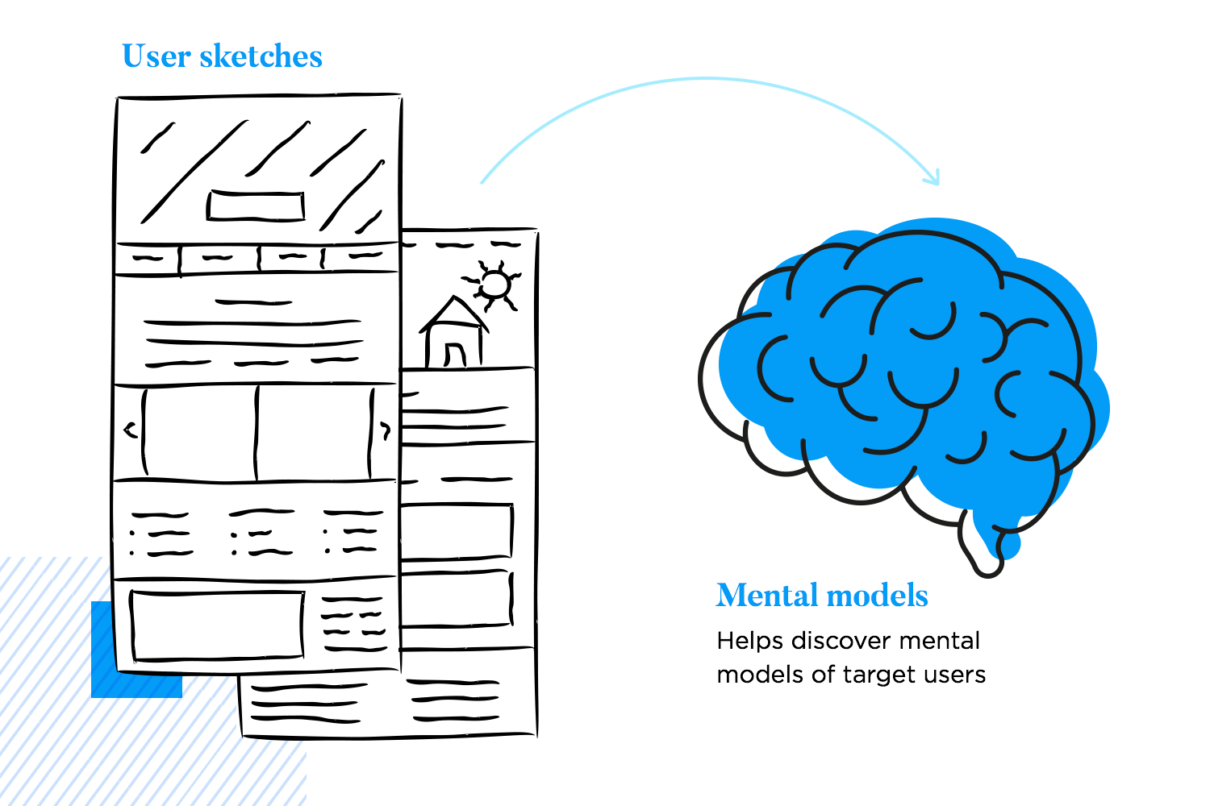
The user-driven prototyping methodology is merely an exercise where you sit down with a user and ask them to draw out how they expect a UI to look or a feature to work.
With this prototyping method, you’re not getting them to design the product, instead, you’re analyzing their sketches to understand their thought processes.

Slide 29
Video prototype:
Use video to illustrate how users will interact with a new system. The goal is to refine a single system concept, making design choices that highlight and explore a particular design path.
Video prototypes are organized as scenarios that illustrate how people might interact with a future technology in a realistic setting.
The focus should be on helping designers to consider the details of how users will react to and control new technology in the context in which it will be used.

Slide 30
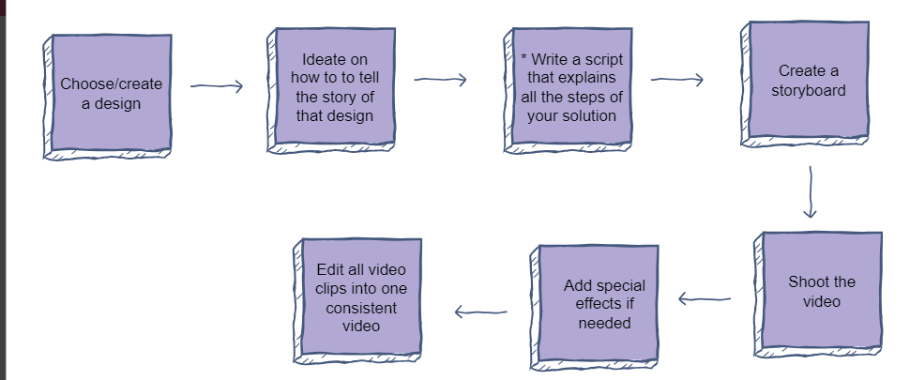
Video prototyping is used by interaction designers to tell a story about a design. Video prototyping allows people to connect with the design as they would in real life. It shows the entire experience through a narrative. Moreover, video prototyping allows all the stakeholders - users, developers, buyers, etc. - to understand the design better.
Notes:
This is used by interaction designers to tell a story about a design
Video prototyping allows people to connect with the design as they would in real life
Show entire experience in term of all stateholders

Slide 31
video prototyping tools
video prototyping tools can be divided into categories based on the level of fidelity and functionality they offer. Low-fidelity tools, such as paper and pencil, whiteboard, or PowerPoint, allow users to create simple and rough sketches of their video idea with basic shapes, colors, and text; these are useful for brainstorming, ideating, and communicating the core concept and flow of a video.
High-fidelity tools like Adobe After Effects, Principle, or InVision Studio enable users to create fully functional and interactive simulations of their video idea with animations, transitions, sounds, and user inputs; these are excellent for testing the usability, performance, and feedback of a video.

Slide 32
